Slide 1
Aws ec2 instance with Terraform Provisioner

Slide 2
Steps
Install terraform and write terraform file
Configure aws through cli
Create ssh key an configure ec2
Creation for file provisioner
Creation for remote execute provisioner for python web app
Run terraform commends
Verify new instance and app.py file and check connections

Slide 3
1.Install terraform write tf file
Go to official page download terraform respective linux flavour
Create terraform file for vpc , ec2 instance
Create resource blocks keypair, vpc, subnet, igw, rt, rtassociation,sg, ec2

Slide 4
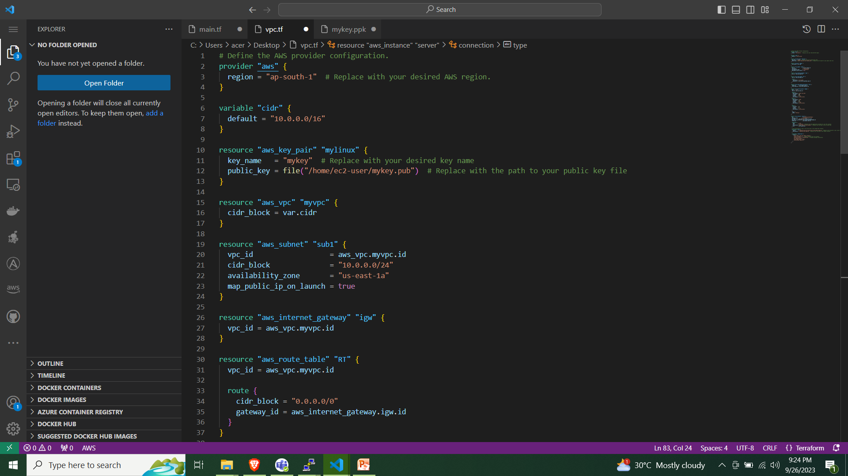

Slide 5
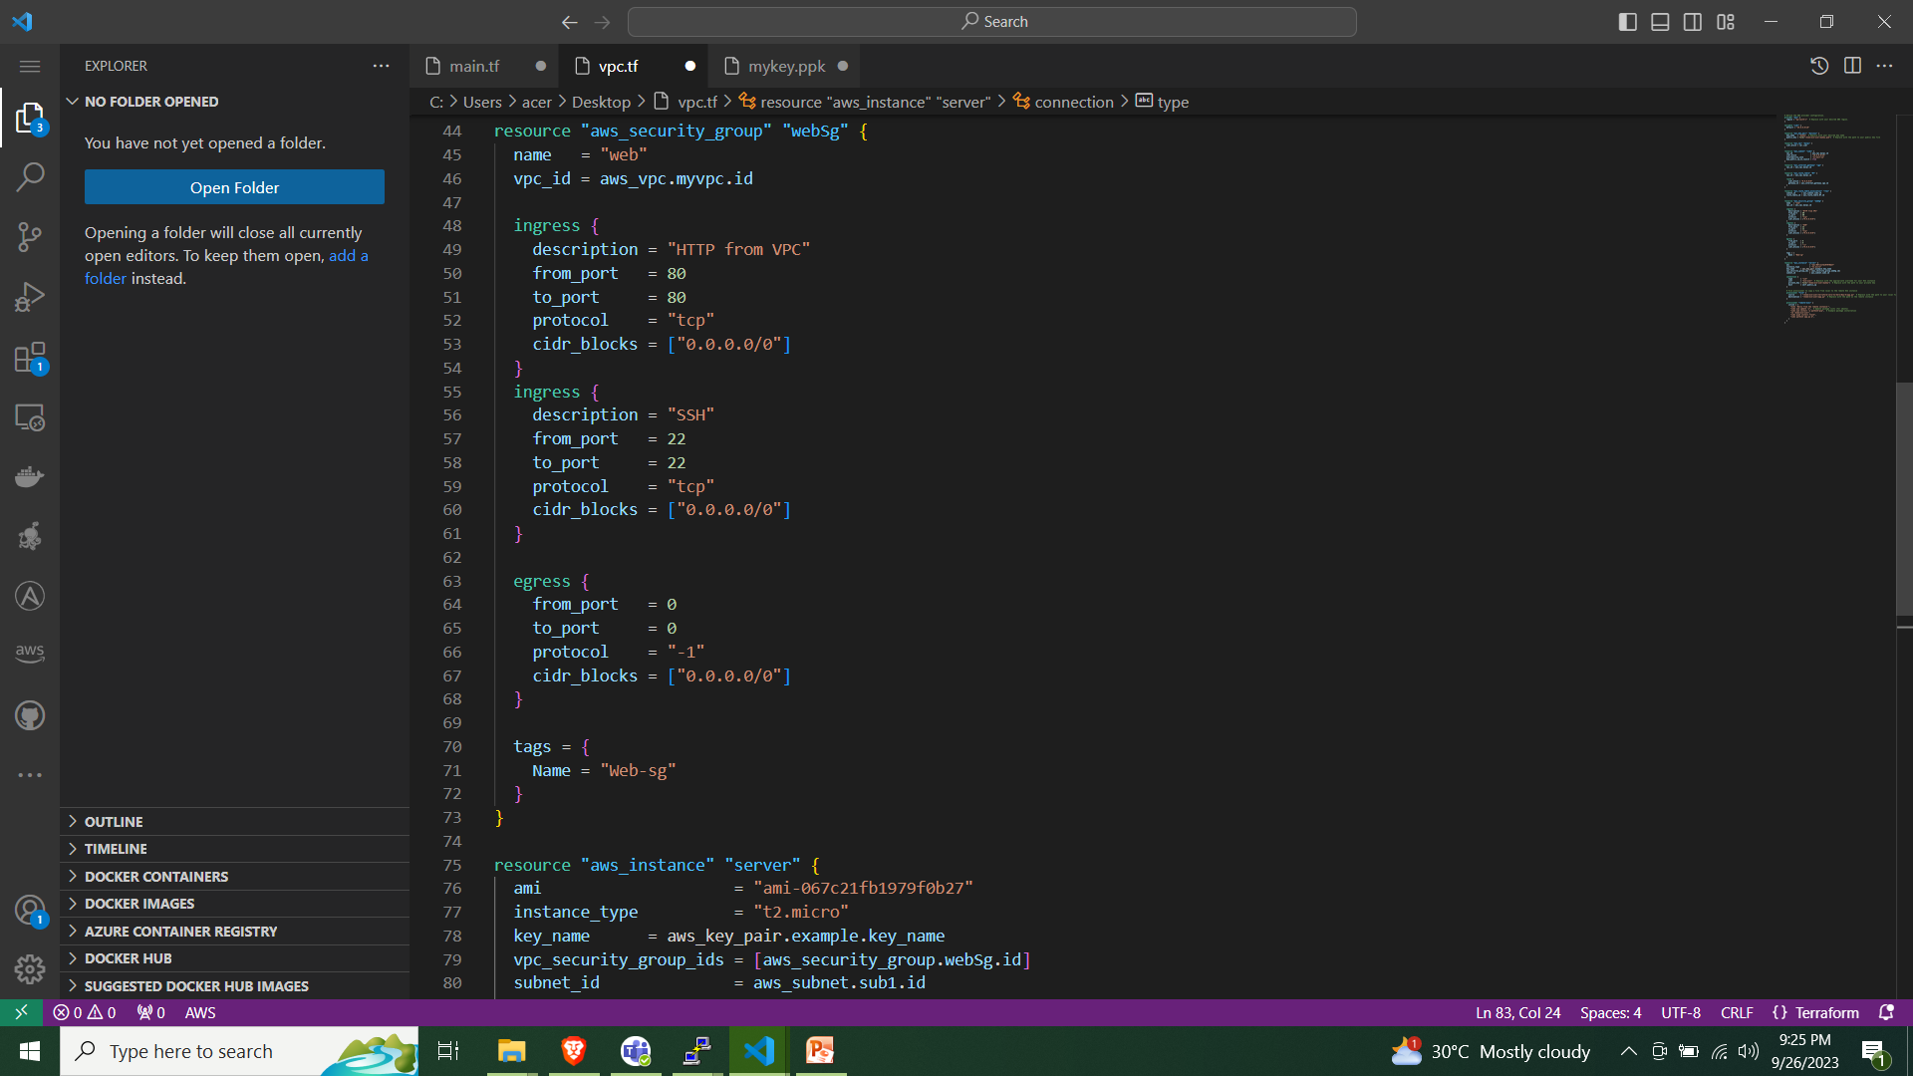

Slide 6
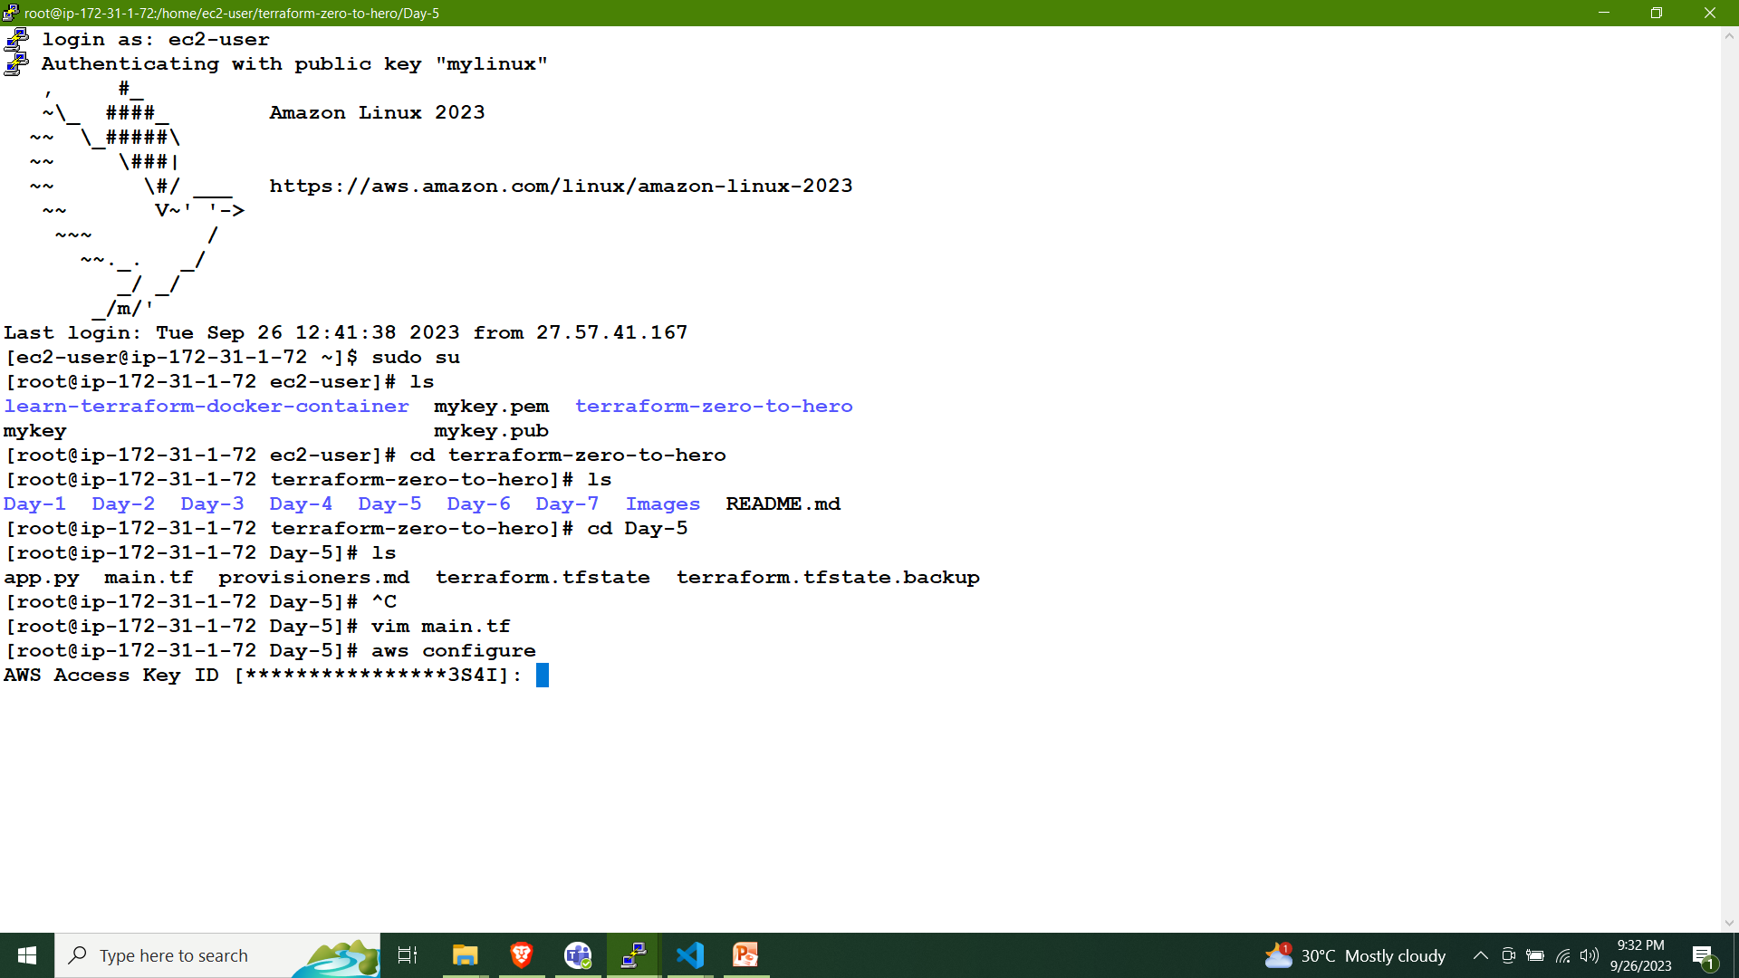
2. Aws configure

Slide 7

3. Ssh key gen and public key set
Set public key path to aws key-pair rsc block

Slide 8
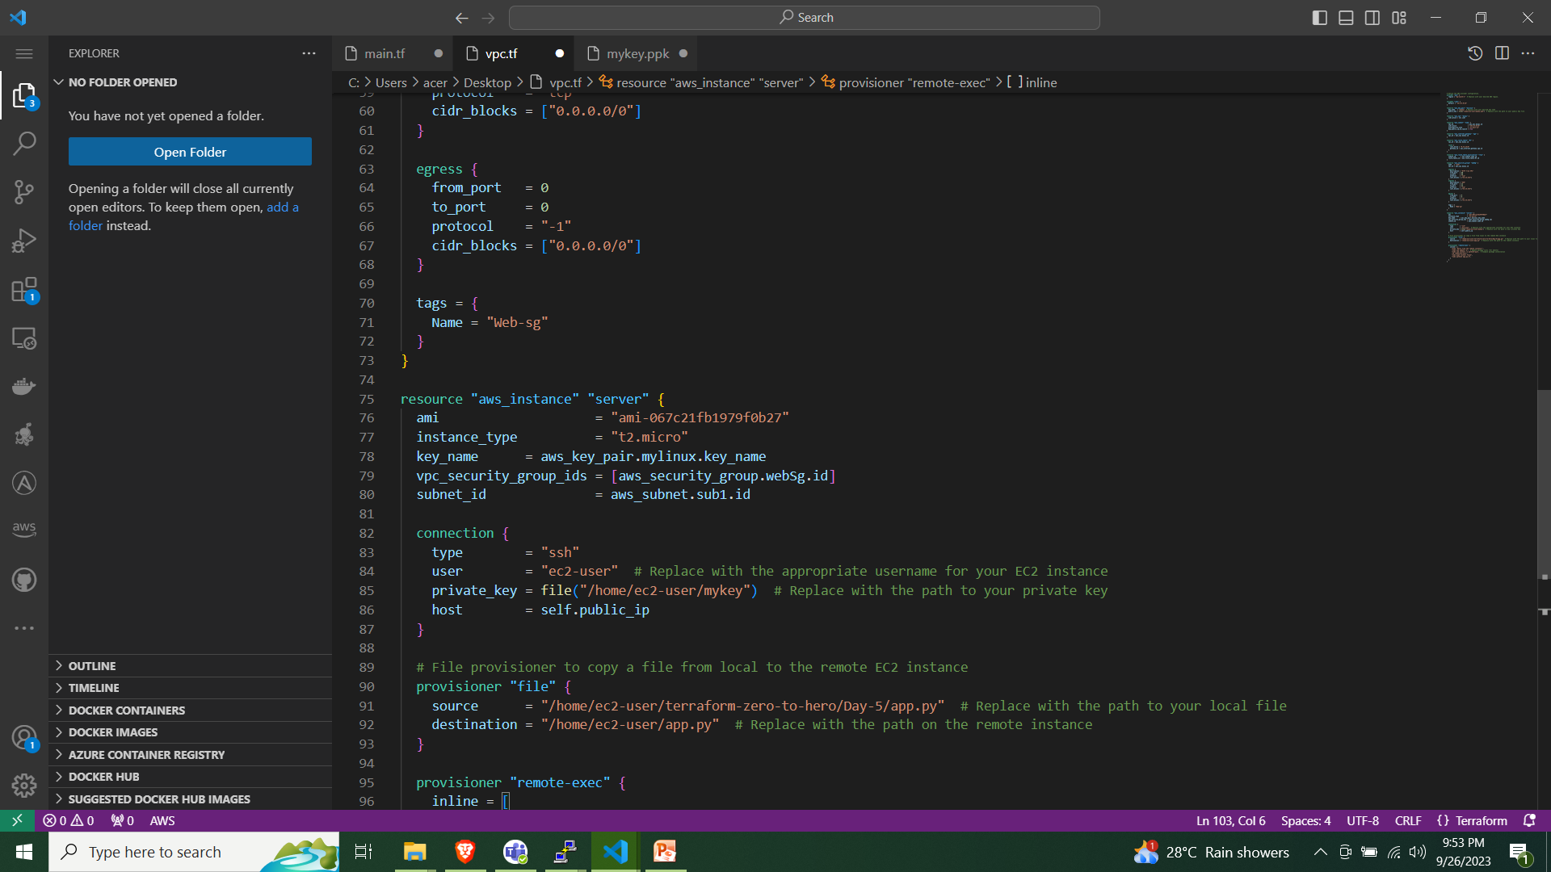
3. Ssh key gen and pvt key set
Set public key path to aws key-pair rsc block

Slide 9
4. Creation file Provisioner
The file provisioner is used to copy files or directories from the local machine to a remote machine

Slide 10
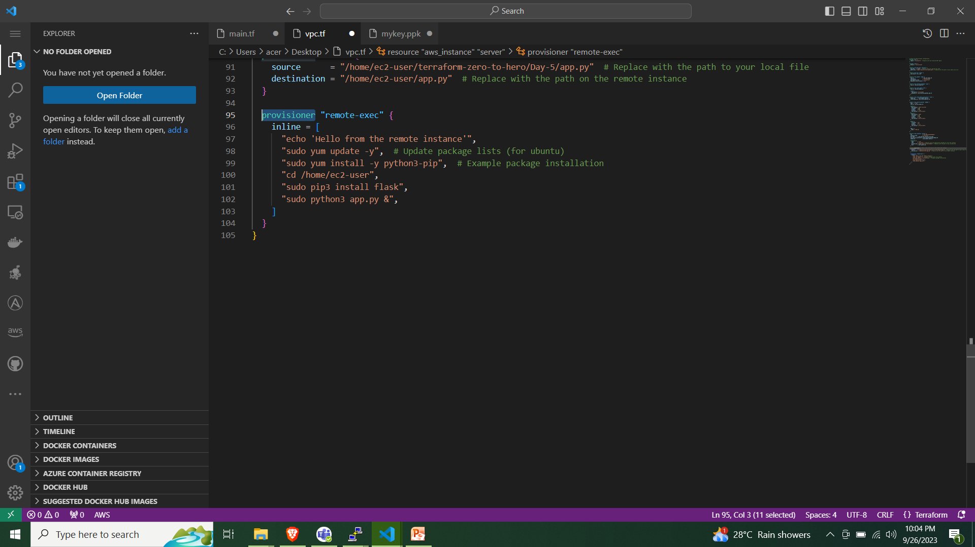
5. Creation remote_exec Provisioner
The file provisioner is used to copy files or directories from the local machine to a remote machine

Slide 11
Run terraform commends
Terraform init
Terraform plan
Terraform validate
Terraform apply
Terraform show
Terraform state list

Slide 12
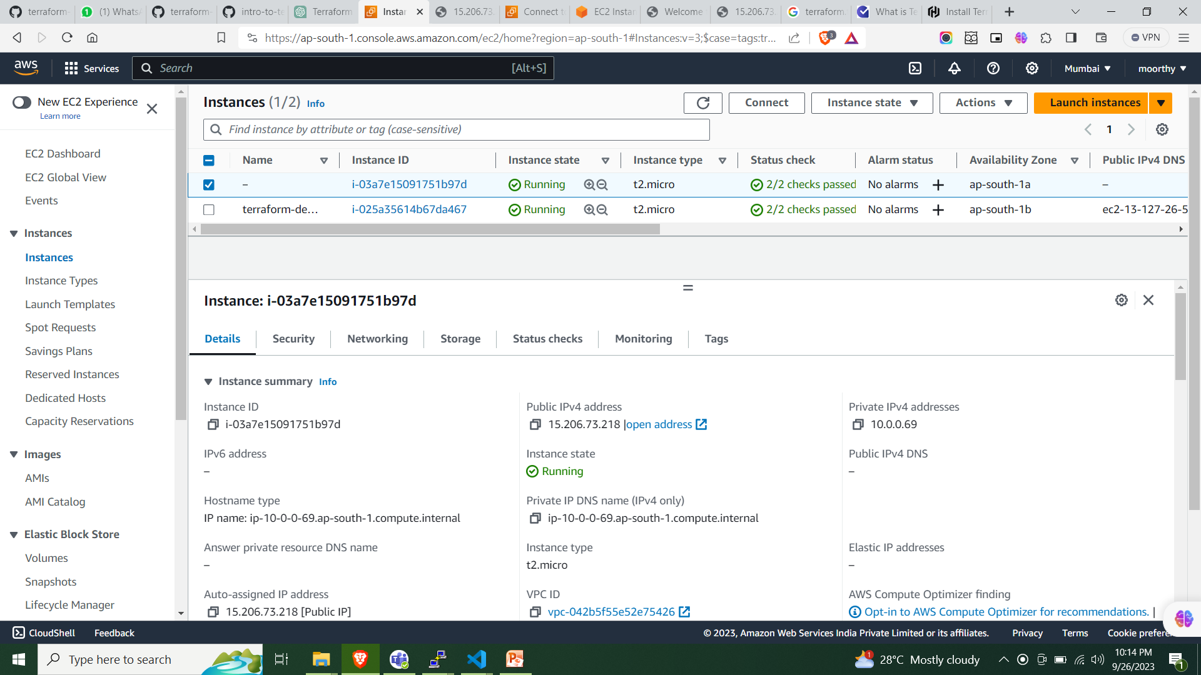
Check aws console and connect ssh

Slide 13
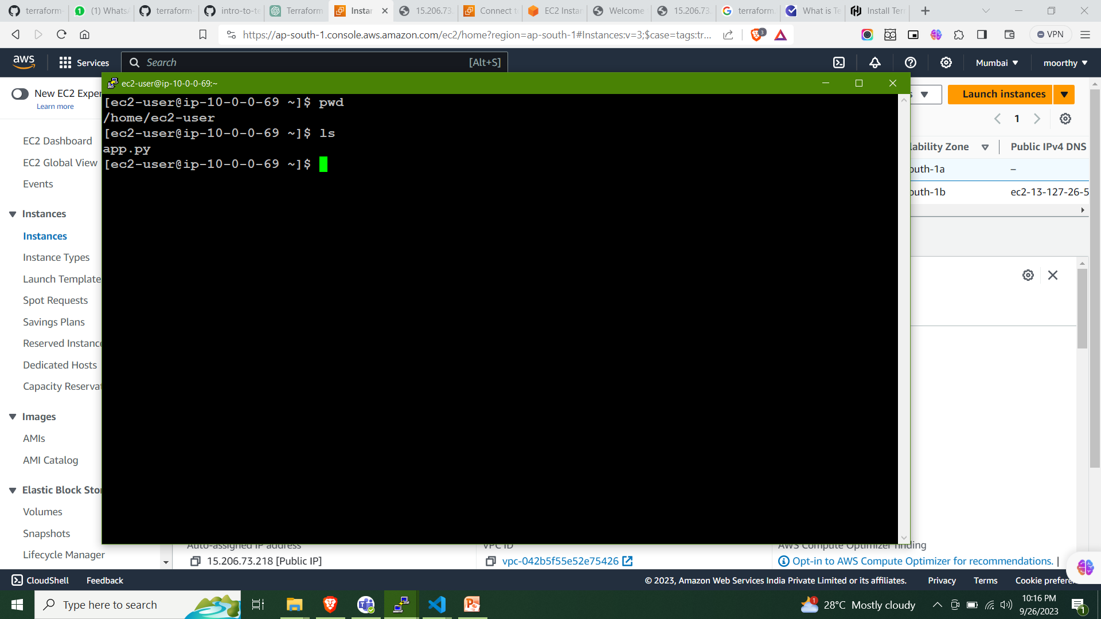
Ssh login ec2.check file provisioner destination matched

Slide 14
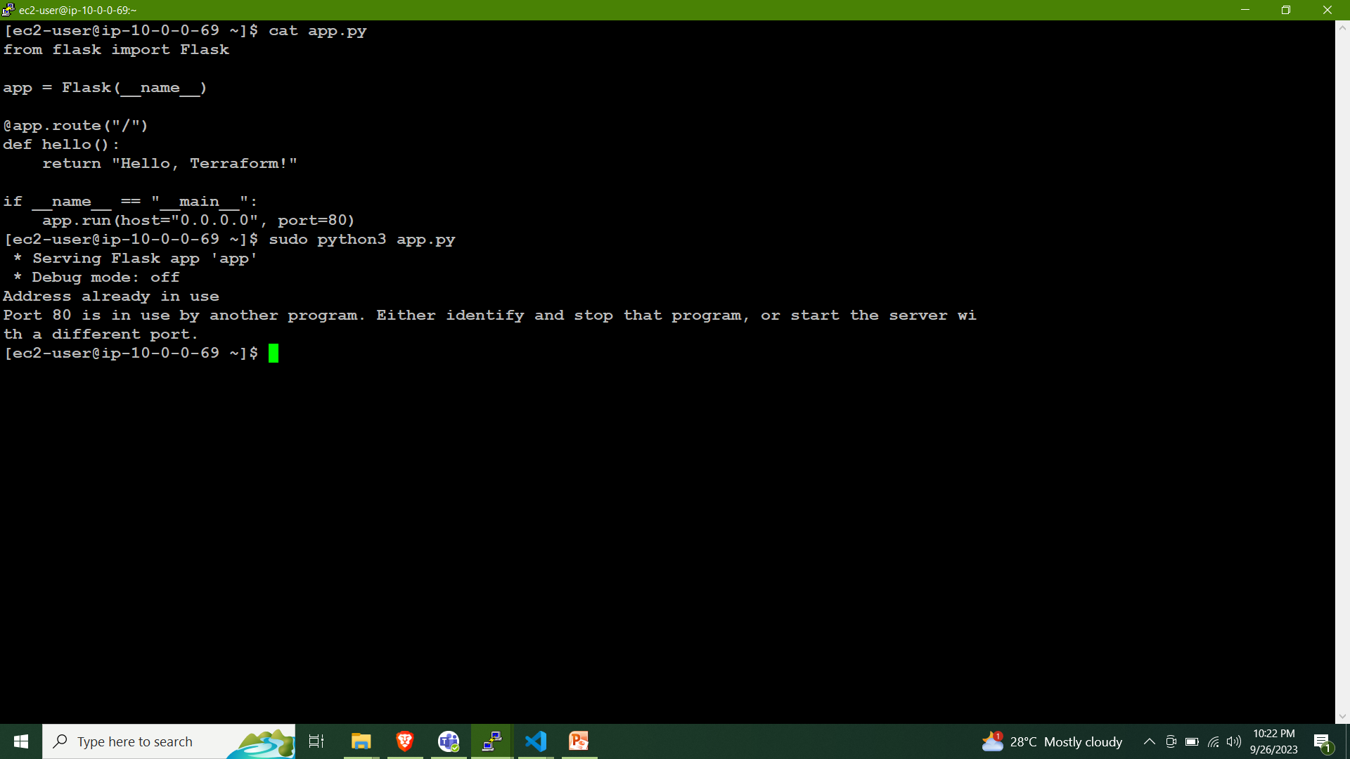
Check app.py and check app connection

Slide 15

Check web connection brower.

Slide 16
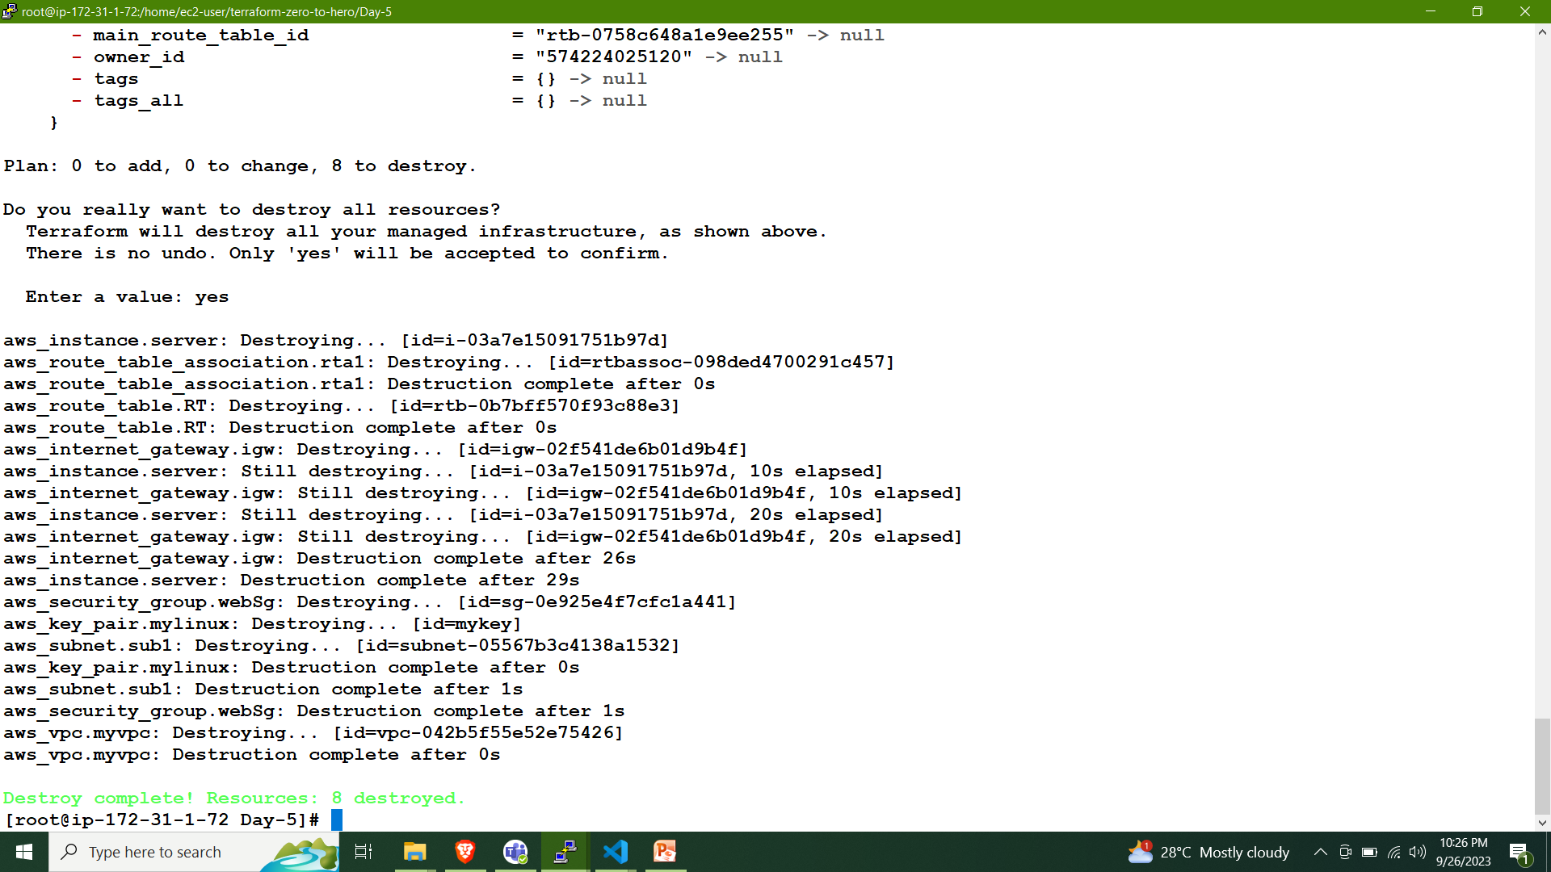
Destroy terraform

